Slide 1

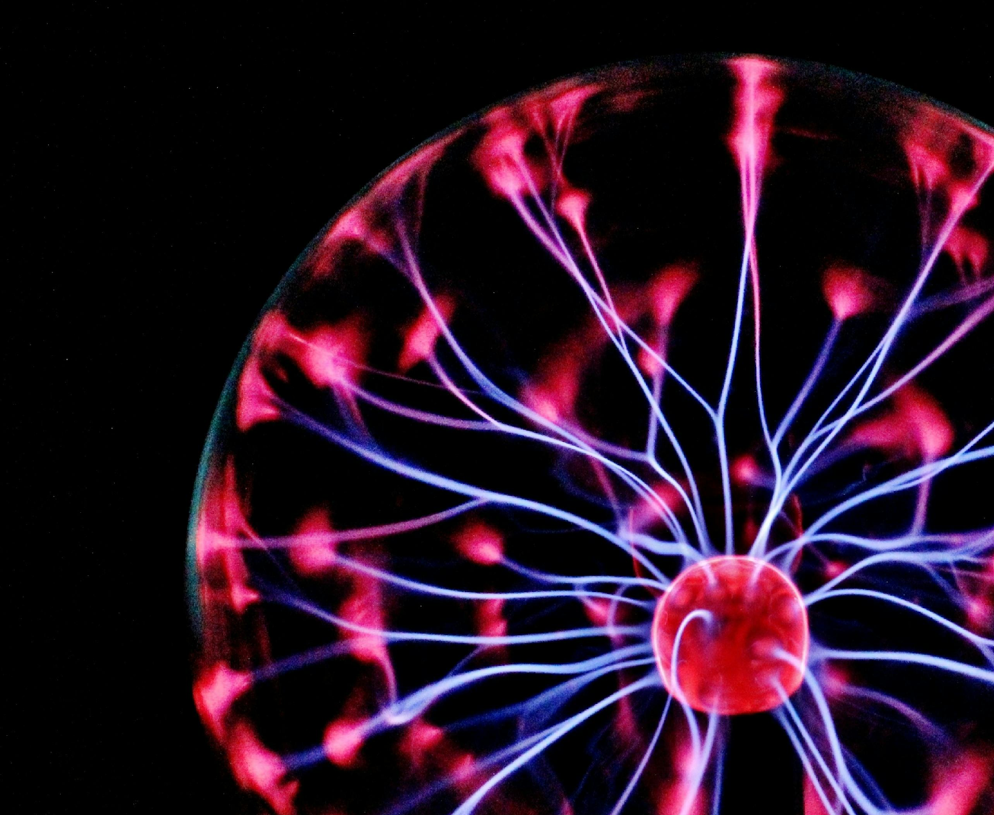
Decoding the rules of RNA colocalization
Session 2
Mohit Joshi
BTech Biotechnology
Semester 7
Institute of Advanced Research

Slide 2
“The central dogma tells us which genes are expressed, but not where in the cell those gene products operate - or how RNAs are spatially organized to carry out coordinated functions and their location.”

Slide 3
Hypothesis: mRNA’s sequence contains “zip code” or set of rules or common sub sequences between each mRNAs that dictates it’s location and neighbouring RNAs.
Method: Deep learning model to predict mRNA’s local transcriptomic neighbourhood directly from it’s neighbour RNA sequence to discover “Rule of Association”

Slide 4
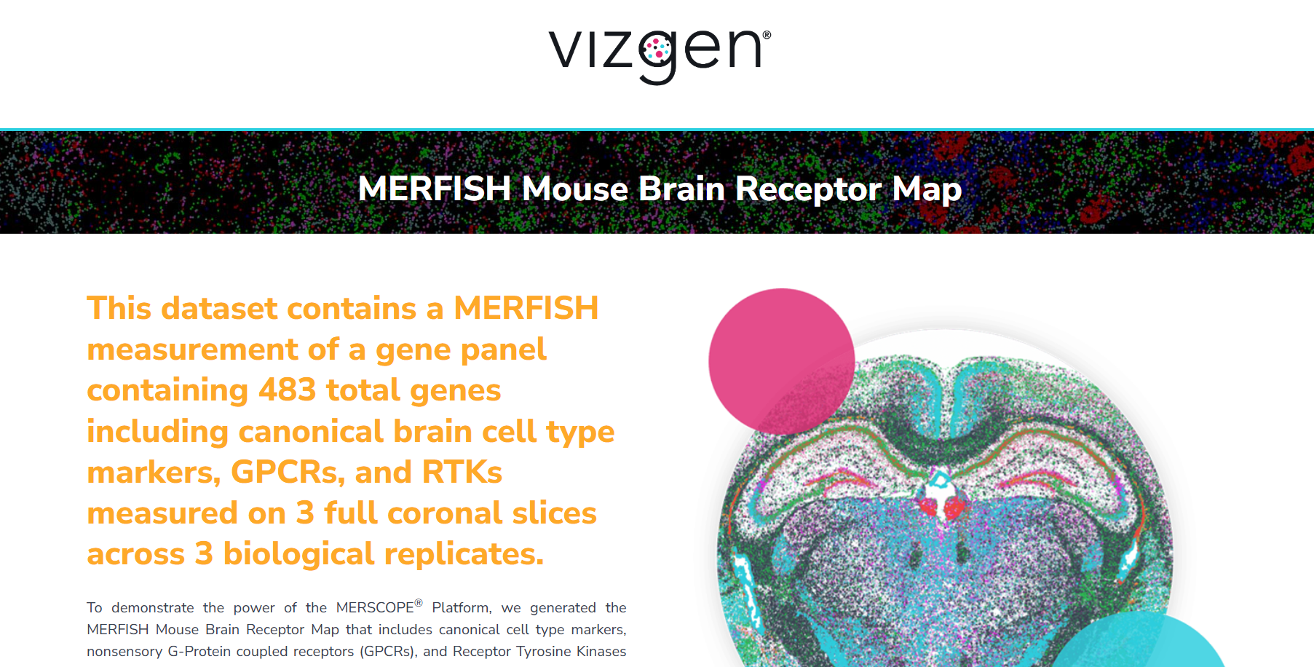
Raw Data (used for our analysis)
MERFISH Mouse Brain Receptor Map

Slide 5
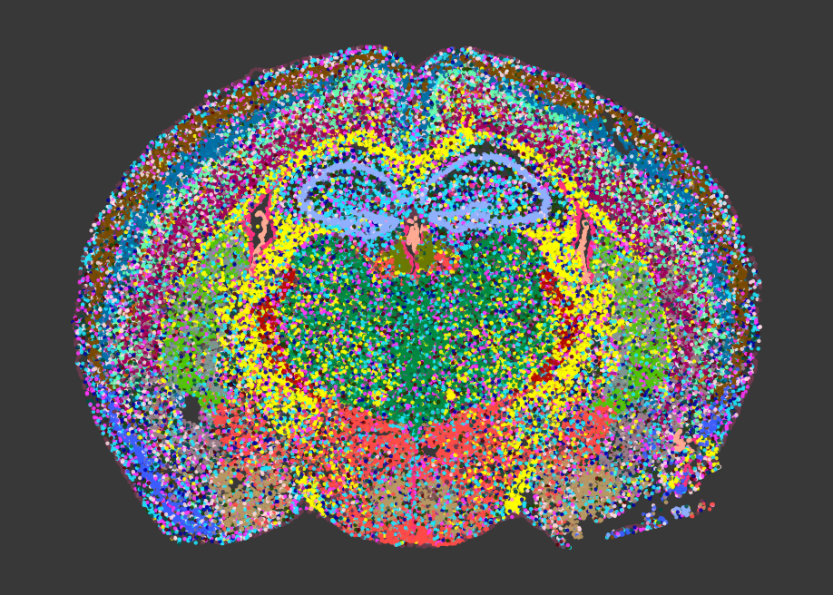
Raw Data (used for our analysis)
Single Cell Spatial map of Mouse Brain

Slide 6
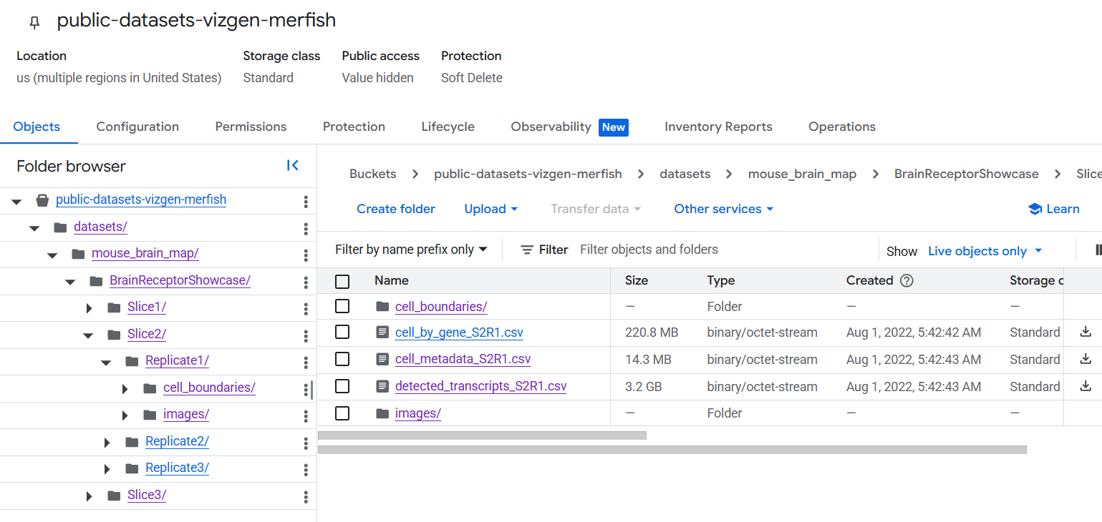
Raw Data (used for our analysis)
MERFISH mRNA data of Mouse Brain

Slide 7
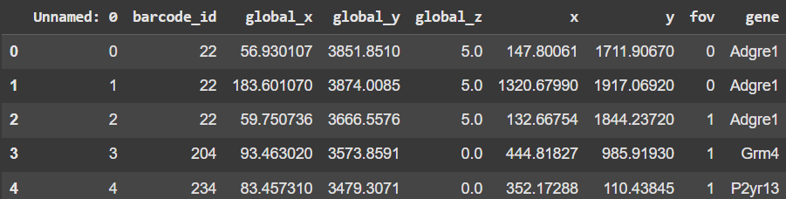
Raw Data (used for our analysis)
MERFISH mRNA data of Mouse Brain

Slide 8
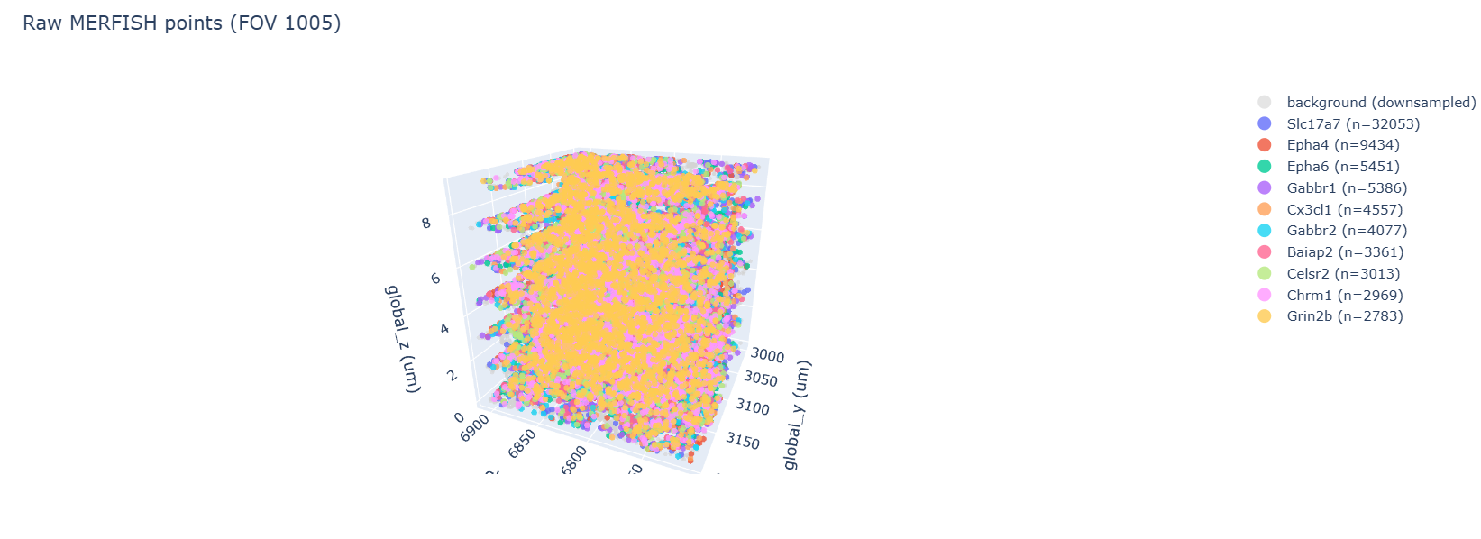
Raw Data (used for our analysis)
MERFISH mRNA data of Mouse Brain
Interactive on Colab

Slide 10
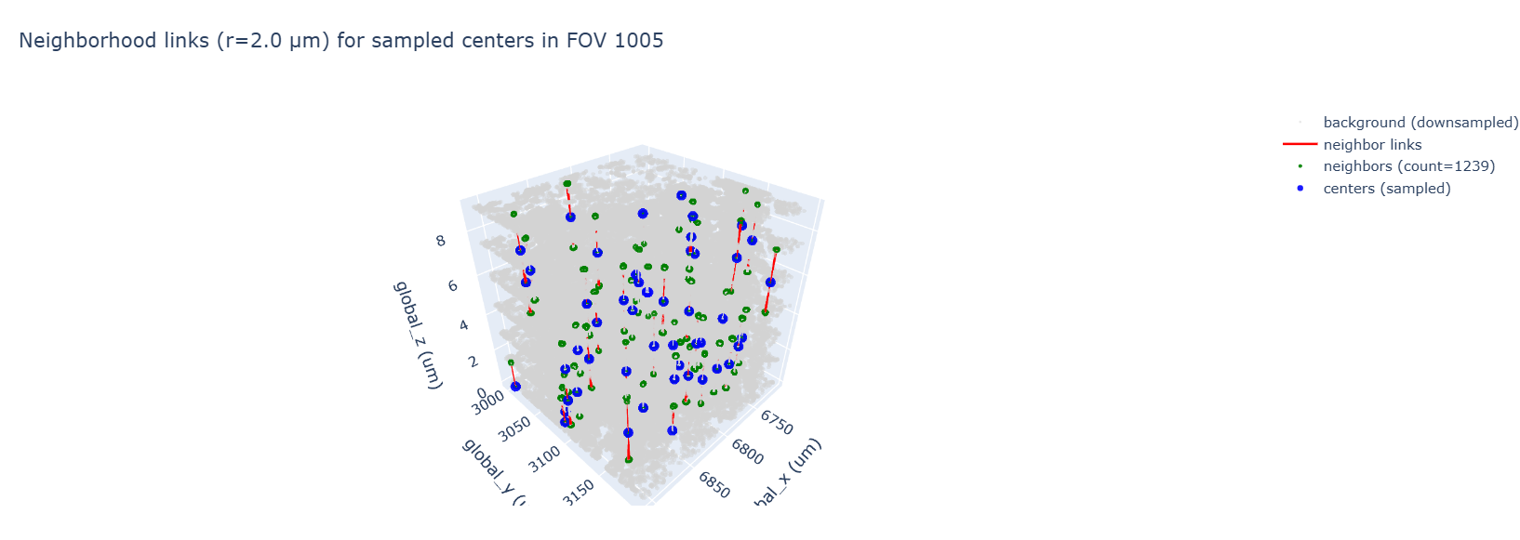
Post Processed Data
MERFISH mRNA data of Mouse Brain
After modelling the radius neighbourhood of the dense and random data

Slide 12
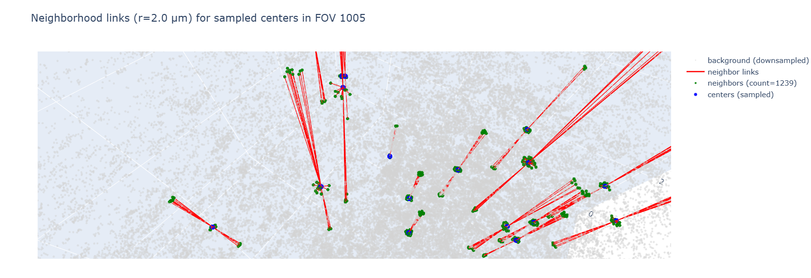

Slide 13
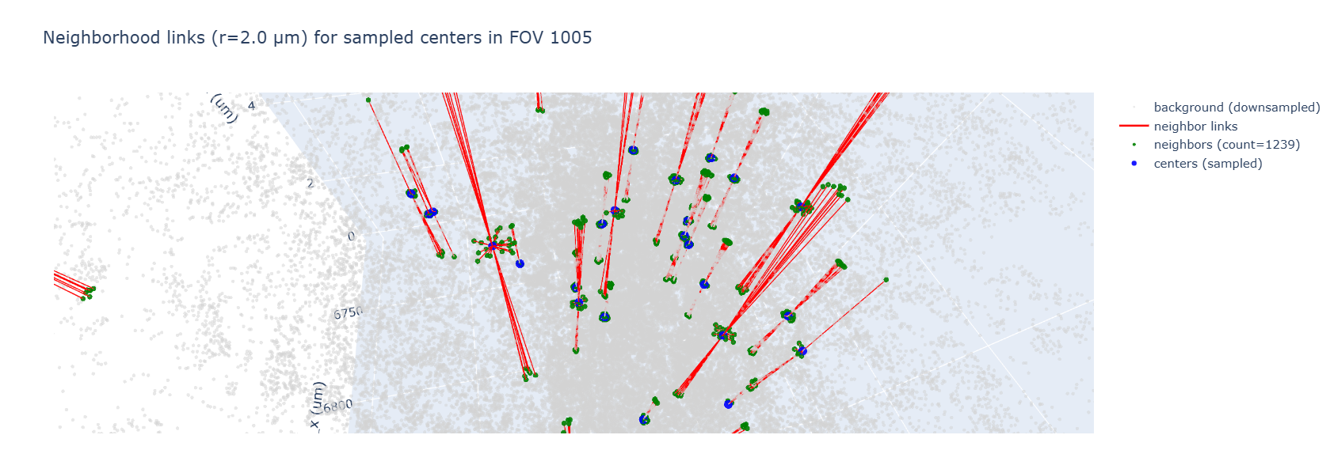

Slide 14
Post Processed Data
MERFISH mRNA data of Mouse Brain
After modelling the radius neighbourhood of the dense and random data
Center idx 104681 (gene=Cx3cl1): 40 neighbors. Top nearby genes: [('Slc17a7', 10), ('Epha4', 4), ('Cx3cl1', 3), ('Celsr2', 2), ('Syt4', 2), ('Nrp2', 2)]
Center idx 129461 (gene=Epha7): 26 neighbors. Top nearby genes: [('Slc17a7', 6), ('Celsr2', 2), ('Grin2b', 2), ('Chrm1', 2), ('Epha4', 2), ('Adgrl3', 1)]
Center idx 126313 (gene=Epha6): 12 neighbors. Top nearby genes: [('Ntrk2', 2), ('Abcc9', 2), ('Slc17a7', 2), ('Axl', 1), ('Htr6', 1), ('Cspg5', 1)]

Slide 15
Analogy
The MERFISH output = a long list of dot coordinates plus a gene label for each dot.
A radius neighbourhood around a dot is like drawing a small circle in microns around that dot and asking: which other labelled dots fall inside this circle? That list of neighbours is the local micro-environment for that transcript.
Why Radius Neighbour grouping? Because many RNAs that share function, transport mechanisms, or binding proteins tend to be physically near each other. If you can learn which sequence features predict “who shows up nearby”, you have candidate zip codes.

Slide 16
Analogy
After finding all the Neighbours and their centres, ensemble them in Transformer
Mechanistic goal: find sequence features (zip codes, motifs) that predict neighborhood composition.
Supervised formulation: each transcript provides one training example:
Input X = nucleotide sequence (or a region like the 3′UTR) from a reference (GENCODE).
Target Y = the observed neighborhood composition (e.g., fraction of neighbors that are gene A, gene B, ... within radius R).
The transformer learns mapping X → Y across many examples. If learned patterns align with known RBPs or motifs, we have candidate causal signals.

Slide 17
Analogy Again
“If many transcripts that share a motif are repeatedly found near one another across cells, that hints the motif is functional for localization.”

Slide 18
Link to the above work
mRNA Colocalisation.ipynb

Slide 19
Thank you

